Slide 1
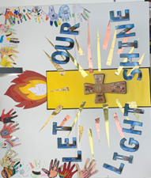
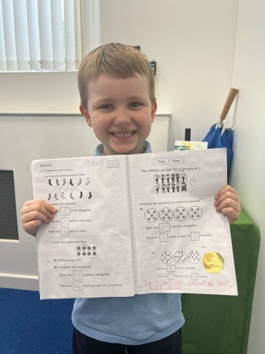
St. John’s Briefing
Monday 10th June 2024

Slide 2
Agenda
Calendar
Good News
Dates for diary
AOB

Slide 3
Magic Breakfast

Slide 4
Thank you Carly

Slide 5
SIAMS CELEBRATION 25th June
Church Service @ ST James the Less
Collective Art Activity
Bouncy Castle in Playground
Classroom Parties PM
Ice Cream Van in PM
Teaparty for staff straight after school

Slide 6
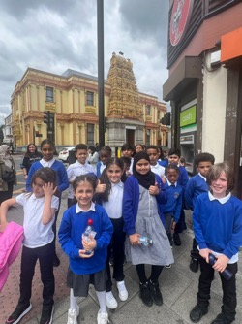
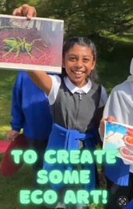
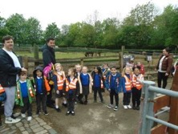
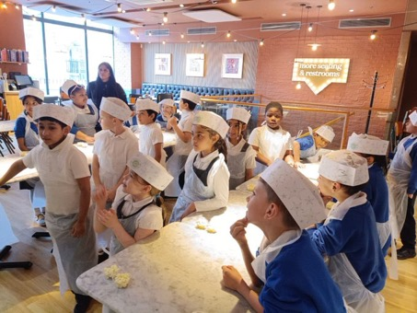
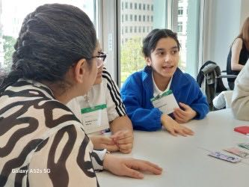
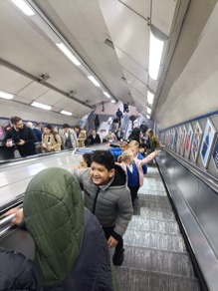
Children out on trips – KEEP BOOKING!

Slide 7
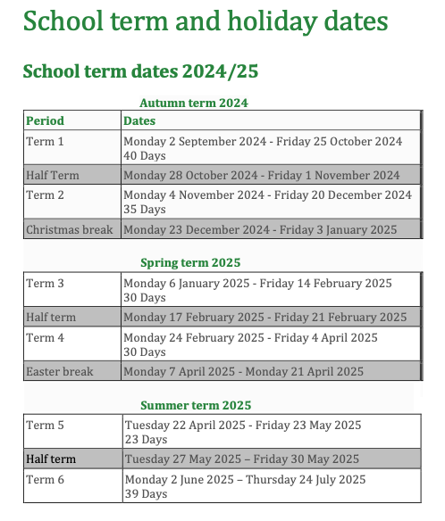

Slide 8
Coming Up..WB 10th June 2024 – Phonics Week Mon 10th Artis DR meeting Head of Mulberry Academy Shoreditch Tue 11th DR at ST Paul’s – Bal leading Lydia meeting Mrs Aylet (Senco) Purple Mash staff meeting Bal meeting new parent Wed 12th Y4 Cricket Festival Y2 Class assembly Bal at St Paul’s lunchtime Thurs 13th CIN Phillips Y1 Trip to Monument Friday 14th Y4-6 Bowling (SEND) TFL Workshop

Slide 9
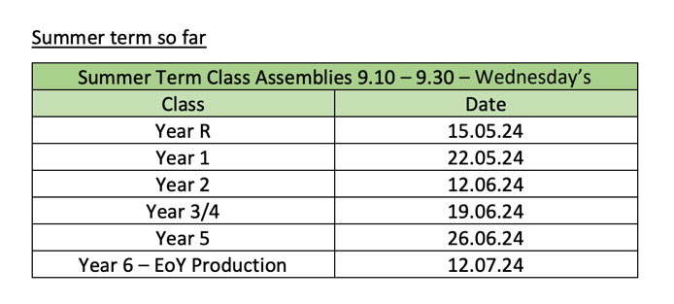
Dates for your Diary

Slide 10
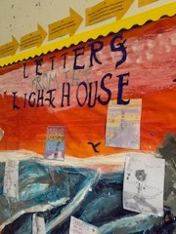
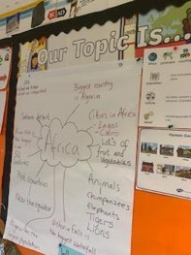
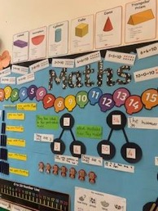
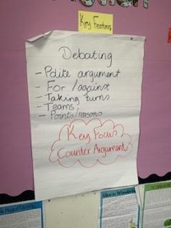
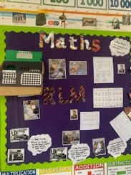
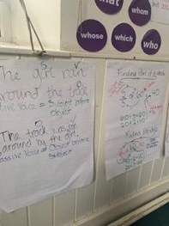
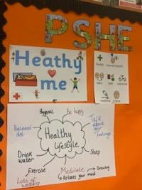
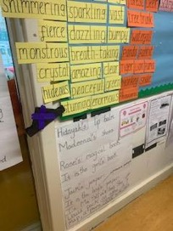
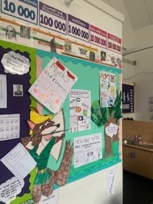
Displays

Slide 11
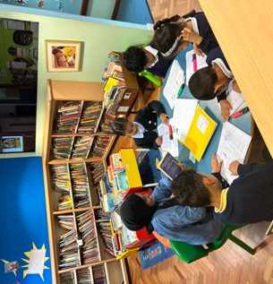
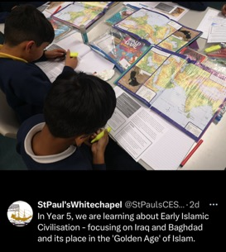
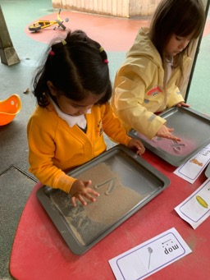
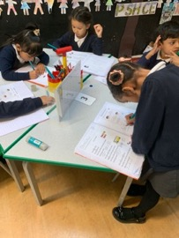
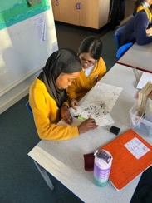
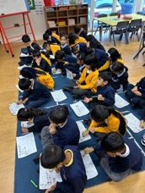
Interactive Teaching and Learning
Things we love to see (in no order!)…
Use of mini whiteboards
Interactive Displays
Teacher modelling work to show good prac and even better if discussion…
Teachers supporting SEN
Support staff engaged with learning – not doing the work for children and working with different groups/individuals
Adaptive groupings
Talk partners
Mixed ability groups/pairings
Story time for all year groups

Slide 12
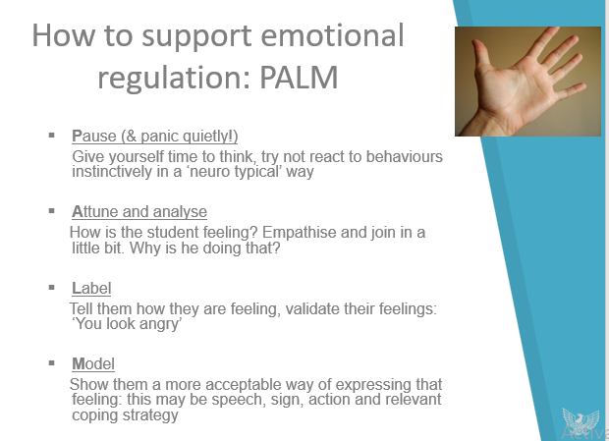
PALM Reminder
Zones of regulation and individual toolkits!

Slide 13
AOB * Email for tech support: support@connetixhelp.freshdesk.com * PPM to do: EYFS, Y1, Y2, * Summer 2 Overviews * Pictures and blurb for newsletter please. – Y trip pics. * Kindness Cup – Y1 * Staircase Spy * John Jones over at St Paul’s this week.

